Slide 1
Virtual Desktop Assistant
Submitted in the partial fulfillment for the award of the degree of
BACHELOR OF ENGINEERING
IN
CLOUD COMPUTING
Submitted by:
VISHU DHAMIJA-4108
SIDDHARTH MISHRA-4105
Under the Supervision of:
HARMANPREET KAUR JHAJJ
Department of AIT-CSE
DISCOVER . LEARN . EMPOWER
1

Slide 2
Outline
Introduction to Project
Problem Formulation
Objectives of the work
Methodology used
Results and Outputs
Conclusion
Future Scope
References
2

Slide 3
Introduction to Project
As we all know, today's generation is shifting more towards technology which is an application of scientific knowledge to the practical aims of human life. Everyday they are presenting new innovative ideas in order to change and manipulate the human environment.
Our digital life is determined by innovations. Especially in recent years, more innovative technologies were developed to facilitate our professional and everyday life. Intelligent personal assistants are an important achievement, which have become an indispensable part of the ubiquitous digitalization process.
3

Slide 4
By using C++ language we made a virtual assistant for our desktop, which is a self-employed worker who specializes in understanding human language and complete tasks as per our demands. Virtual assistants learn over time and get to know your habits and preferences, so, they're always getting smarter.
These virtual assistants can be found in all gadgets such as smartphones, tablets and also smart watches now. The increasing competition in this area has led to many improvements. Big companies like Amazon, Google, Microsoft and Apple offer a complete digital infrastructure that can be controlled by voice assistants.
4

Slide 5
These virtual assistant must be connected to the internet so it can conduct web searches and find answers or communicate with other smart devices.
However, since they are passive listening devices, they usually need a wake word or command to activate. That said, it's not unheard of that the device could start recording without a wake word.
5

Slide 6
Problem Formulation
This project will help to reduce the human efforts and make it easier for user to get the answer instantly.
At this time, when everyone to do work from home. So this is best time for us to shift towards technologies in different fields.
Many times we are not able to find any application and we are in a hurry. This project can be proved very beneficial for this.
We already have multiple virtual assistants. But we hardly use it. There are number of people who have issues in voice recognition. These systems can understand English phrases but they fail to recognize in our accent.
6

Slide 7
There is need of a virtual assistant that can understand English in Indian accent and work on desktop system.
Virtual assistant should be able to model complex task dependencies and use these models to recommend optimized plans for the user. It needs to be tested for finding optimum paths when a task has multiple sub-tasks and each sub-task can have its own sub-tasks.
It can save a lot of time as it works and process in a seconds and saves energy.
7

Slide 8
Objectives
The objectives of this virtual desktop Assistant is that it always asked the owner of the system for a password , it increases the security of someone’s personal information.
It saves a lot of time as user just have to type to open any software or application . There is no need to search every time.
It makes interaction with system more easier and efficient.
8

Slide 9
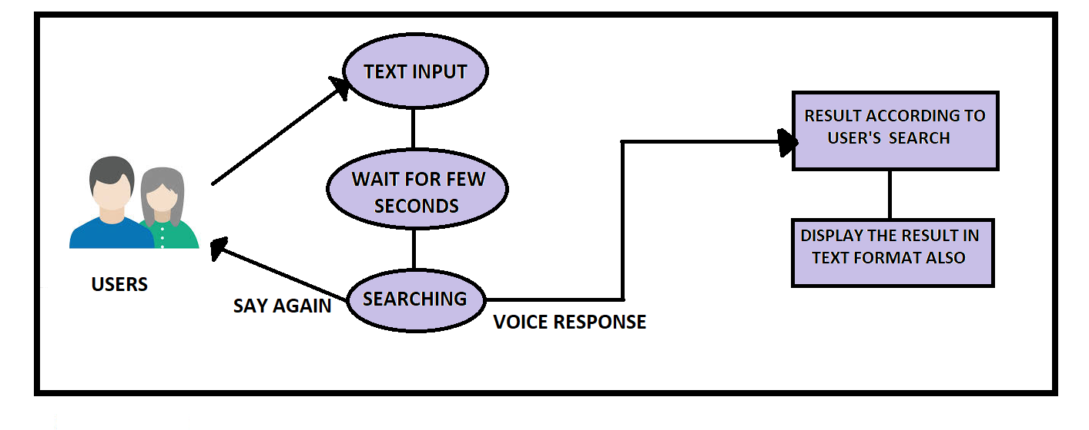
Methodology used
9

Slide 10
Methodology used
In this program, it takes input from user in text format. Then process and search according to input.
If it is asking to open a browser or application, it will open it in a few seconds if available otherwise ask for input again.
If user is asking any question, then it will reply in both voice and text format.
If it is not available, then will ask to enter input again.
10

Slide 11
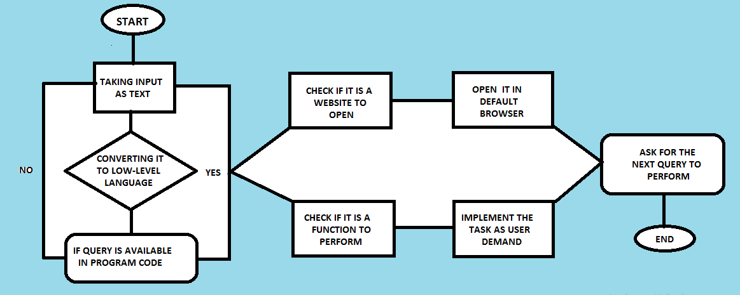

Slide 12
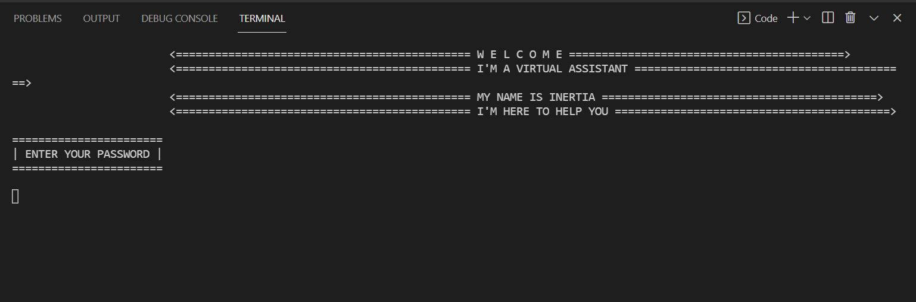
Results and Outputs
Starting of the program, asking for password from user
12

Slide 13
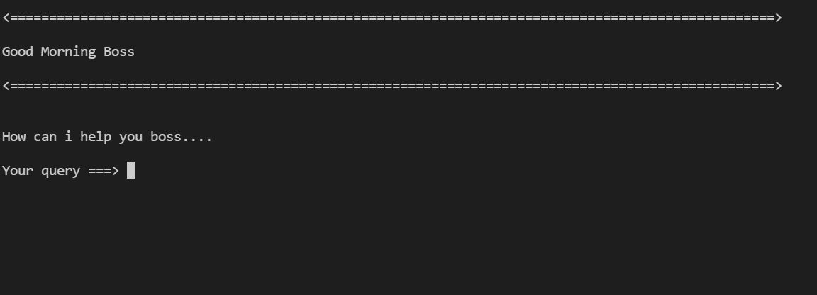
Greeting the user

Slide 14
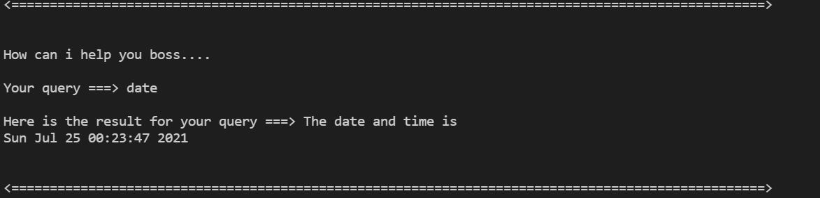
Showing Date and Time

Slide 15
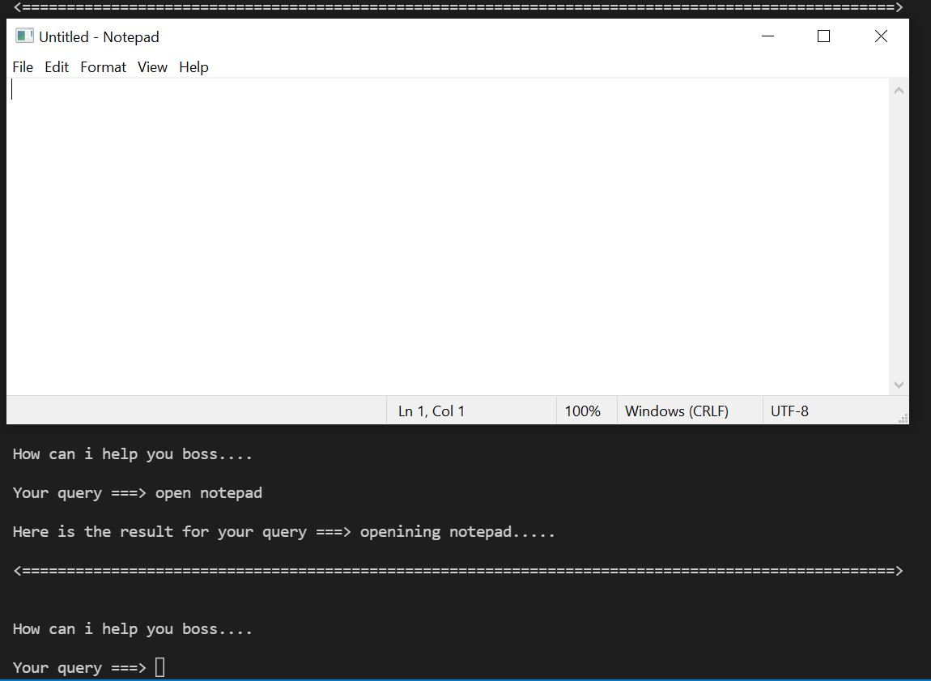
User asking for opening Notepad

Slide 16
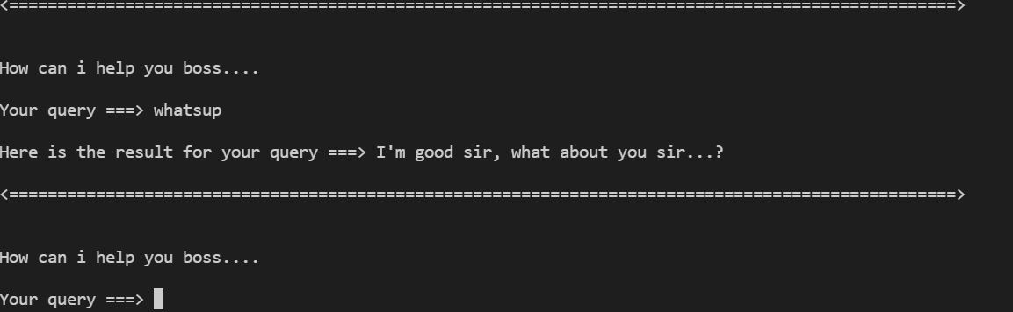
Answering Questions by user

Slide 17
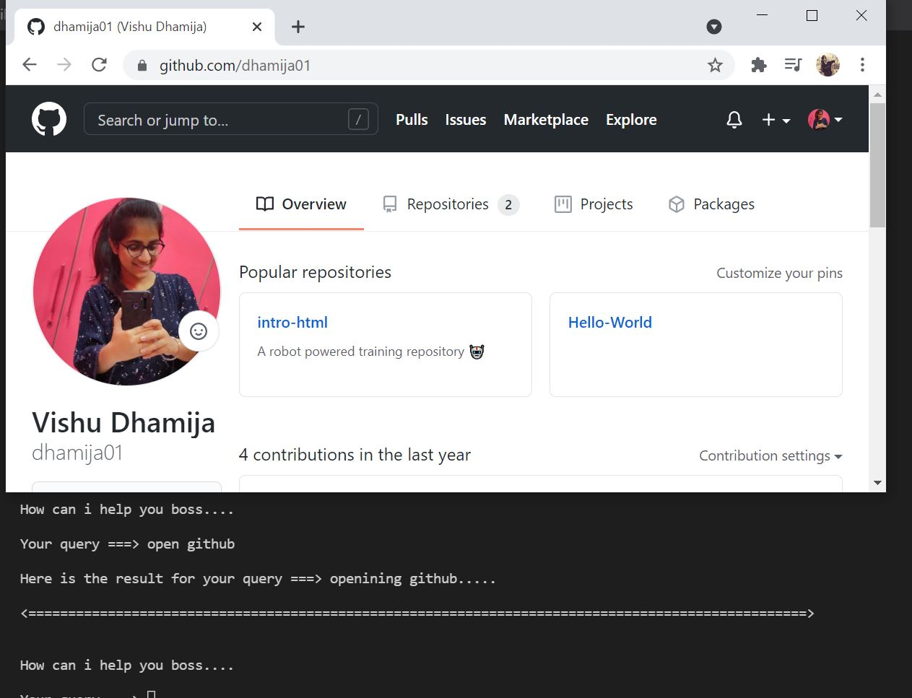
User asking for opening github

Slide 18
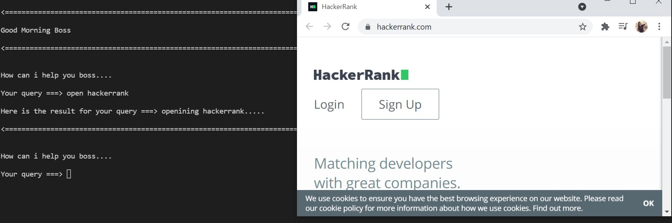
Opening hackerrank

Slide 19
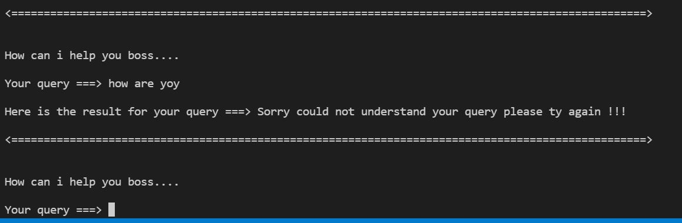
Asking for input again if unable to recognize

Slide 20
Conclusion
This project gave us a very clear understanding about real world problem. It has provide us a deeper insight into connecting databases with servers.
The entire learning outcome of this project has proved to be immensely beneficial for our future learning and understanding.
It gives me a clear idea about personal virtual assistants.
Working with espeak was quite new, but get to learn new concepts through this project.
20

Slide 21
Future Scope
This project can be proved as a time and saving concept as a personal desktop assistant.
It makes interaction among user and system more efficient.
These kind of technologies reduces and leisure human efforts to a greater extent.
21

Slide 22
References
https://library.concordia.ca/help/writing/literature-review.php
https://www.upwork.com/hire/virtual-assistants/
https://www.upwork.com/hire/virtual-assistants/
https://en.wikipedia.org/wiki/Virtual_assistant
https://www.lifewire.com/virtual-assistants-4138533
https://medium.com/keyreply/defining-virtual-assistants/
https://www.youtube.com/watch?v=MNjAvPdt0ZQ&t=15s
22

Slide 23
Continued
https://www.youtube.com/watch?v=pbnQJsbWYNA
https://www.youtube.com/watch?v=emaO7f8LFQE
https://en.wikipedia.org/wiki/Visual_Studio_Code
https://www.youtube.com/watch?v=MC2K6yotimY
http://espeak.sourceforge.net/
https://en.wikipedia.org/wiki/ESpeak
https://en.wikipedia.org/wiki/ESpeak#Features
23

Slide 24
THANK YOU!

